Slide 1
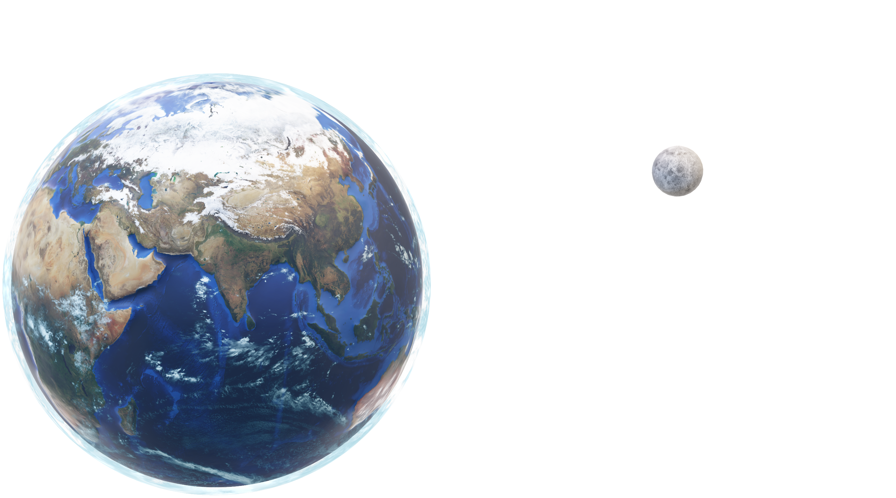
Global
Vision
1
EARTH
O

Slide 2
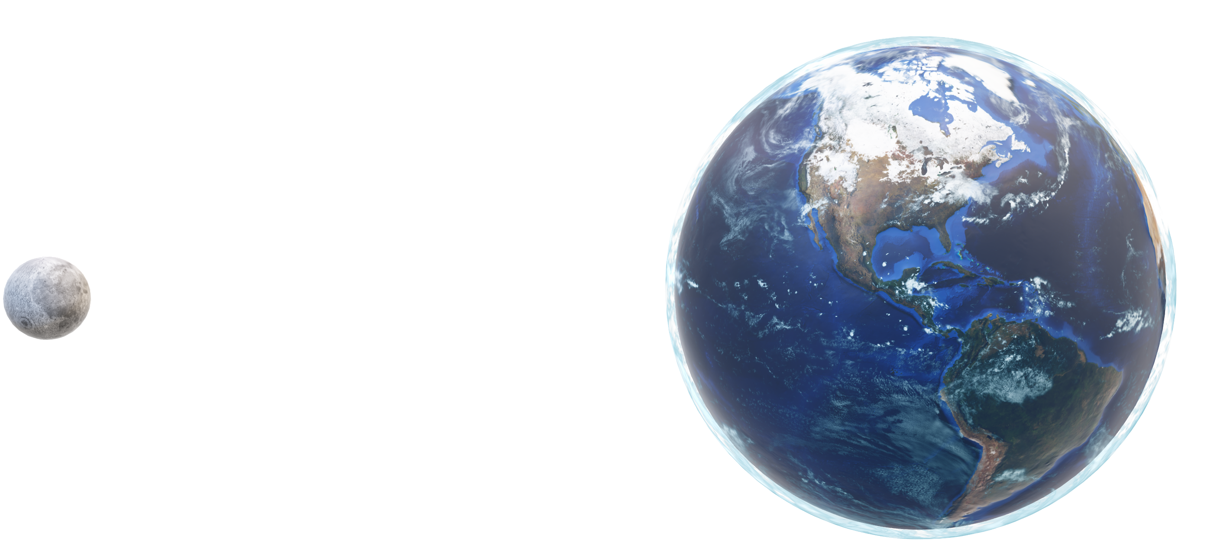
Global Vision
North America
North America - in strict Geographical terms means all the land area from Panama to the North Pole; all the islands in the Eastern Pacific and Caribbean from Greenland to Bermuda, the Bahamas and in the Caribbean, though there’s some debate about Trinidad; and all the Pacific Islands east of the International Dateline and north .The bulk of the continent contains the second and third or fourth largest countries in the world.

Slide 3
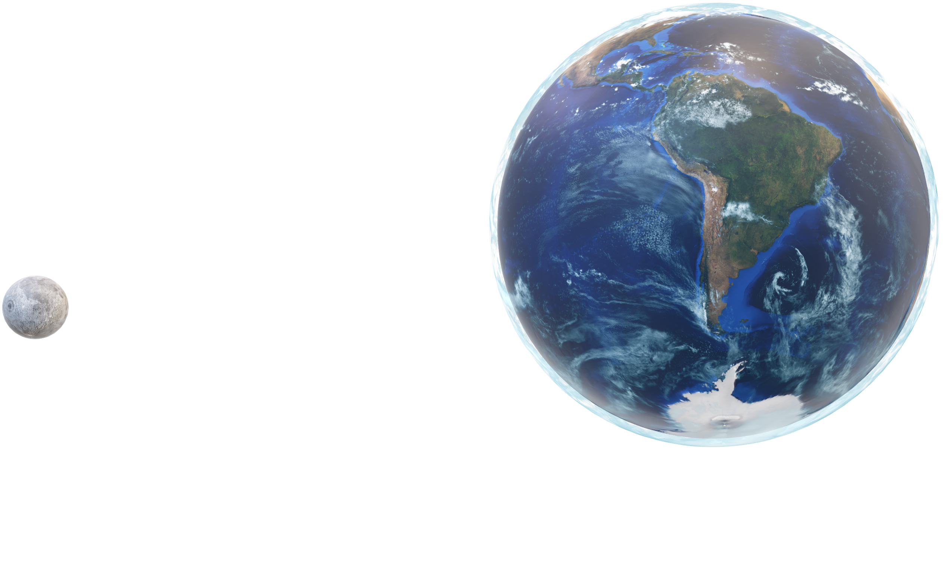
Global Vision
South America
South America human landscape is deeply influenced by indigenous and immigrant populations and their connection to the physical environment. South America, the fourth-largest continent, the continent includes the Galápagos Islands, Easter Island, the Falkland Islands. South America physical geography, environment and resources,
can be considered separately.

Slide 4
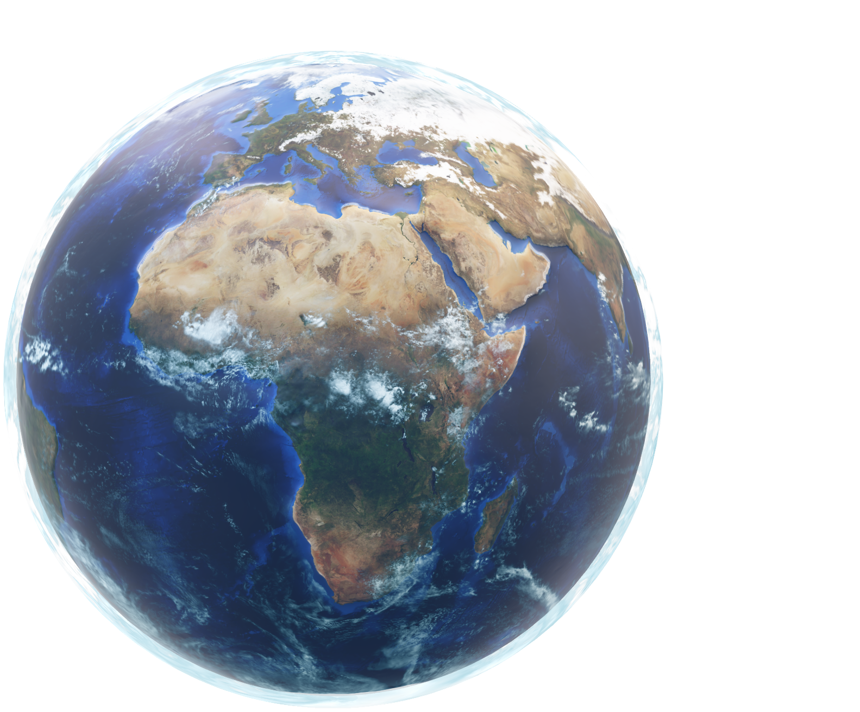
Global Vision
Africa
Africa, the second-largest continent, is bounded by the Mediterranean Sea, the Red Sea, the Indian Ocean, and the Atlantic Ocean. It is divided in half almost equally by the Equator. The continent includes the islands of Cape Verde, Madagascar, Mauritius, Seychelles, and Comoros. Africa’s physical geography, environment and resources, and human geography can be considered separately.

Slide 5
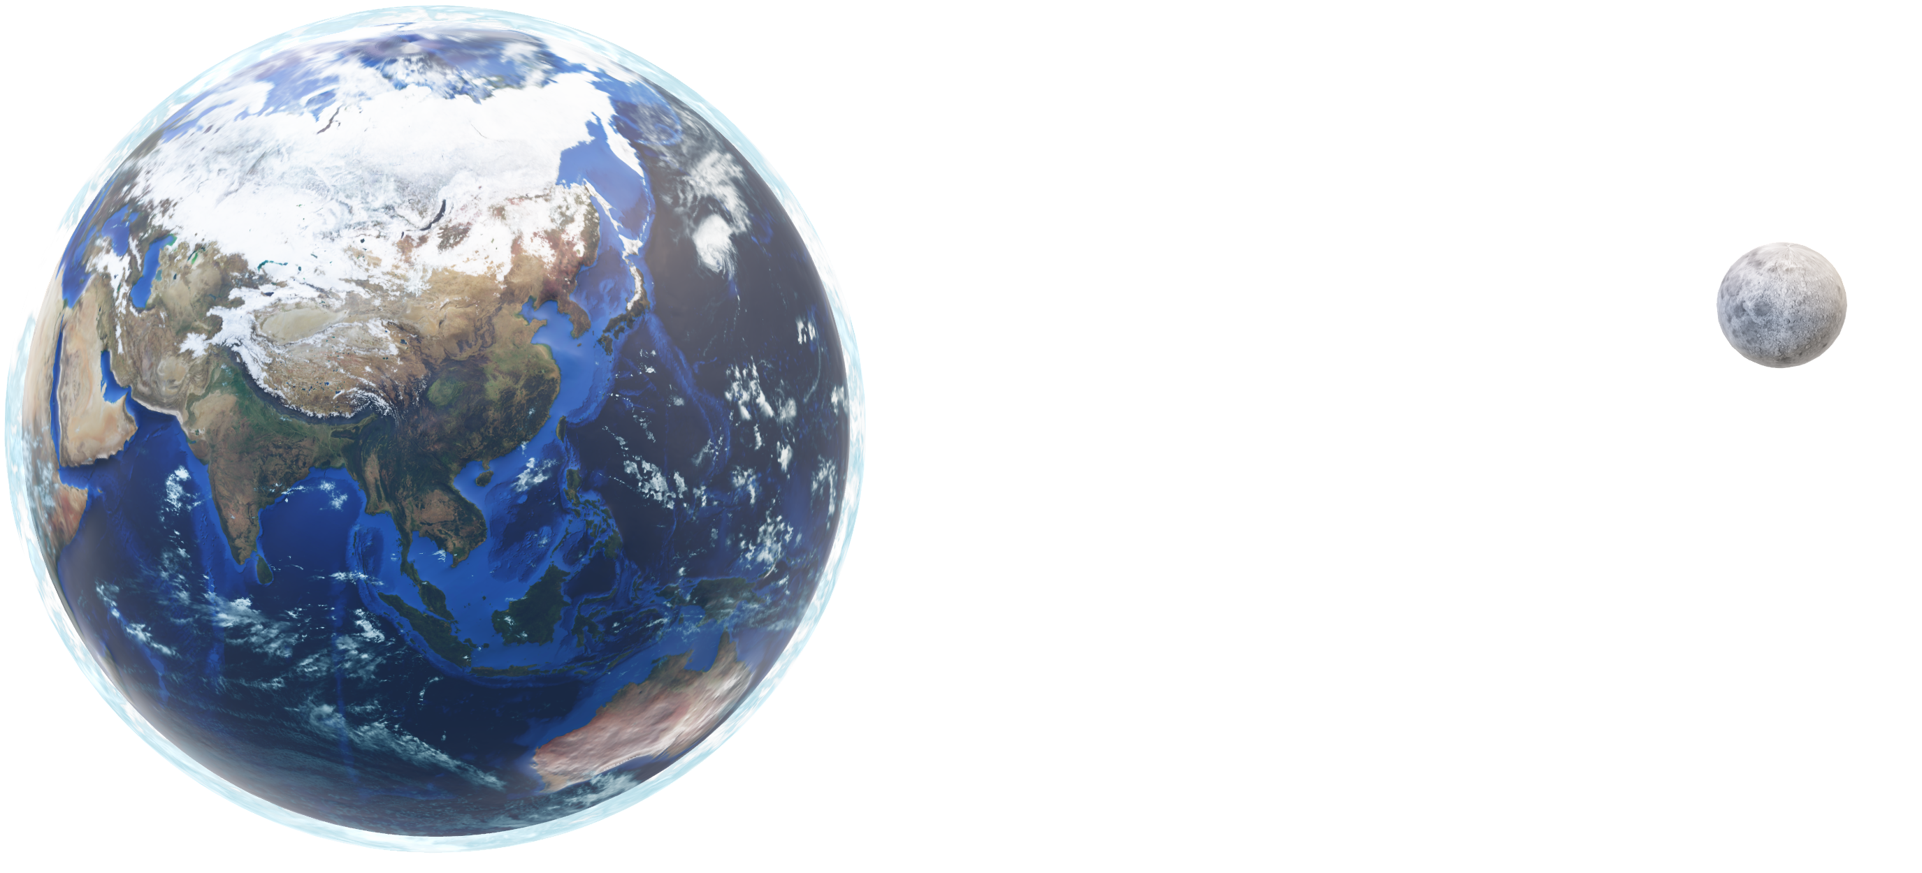
Global Vision
Asia
Asia is the largest of the world’s continents. It can be divided into five major physical regions: mountain systems, plateaus, plains, steppes and deserts, environments and saltwater environments.Asia makes up the eastern portion of the Eurasia supercontinent.Asia is bordered by the Arctic, Pacific, and Indian Oceans. Asia physical geography, environment and resources can be considered separately.

